Slide 1






Lecture 21:
Vite Setup
Course - Web Development - II
-By
Instructor Name
welcome@krmangalam.edu.in
Sohna Road,Gurugram,Haryana 122103

Slide 2

| Table of Contents
Introduction to Vite
Project Creation
Folder Structure
References.
The End.

Slide 3
| What is Vite?
Vite (pronounced "veet", French for fast) is a modern build tool for front-end development that helps you start and run web projects faster than older tools like Webpack.
It was created by Evan You (the creator of Vue.js) and is now widely used in React, Vue, Svelte, and more.
Think of Vite like a modern microwave:
Older tools (like Webpack) are like an oven — slow to start and takes time to heat up.
Vite is instant, fast, and knows exactly what to heat, saving time during development.

Slide 4
| Why use Vite?
Feature | What It Means
Blazing Fast Startup | Uses native ES Modules and skips bundling on dev start
Hot Module Replacement (HMR) | Instantly updates only the changed parts of your app
Zero Config | Works out-of-the-box — minimal setup needed
Optimized Build | Uses Rollup under the hood for fast production builds
Framework Agnostic | Works with React, Vue, Svelte, Lit, etc.

Slide 5
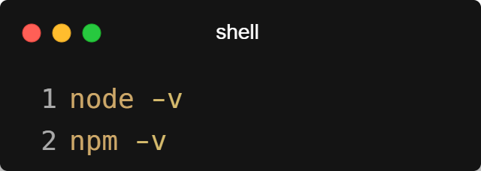
| Creating First React App with Vite
Step 1: Install Node.js
Make sure Node.js is installed (v14+ recommended).
Check with:

Slide 6
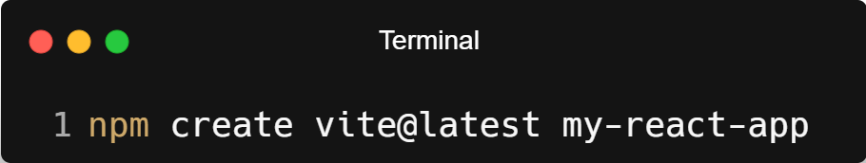
| Creating First React App with Vite
Step 2: Create a New Vite + React Project
In your terminal, run:
Then follow the prompts:
Project name: my-react-app (or your project’s custom name)
Select framework: React
Select variant: JavaScript or TypeScript

Slide 7
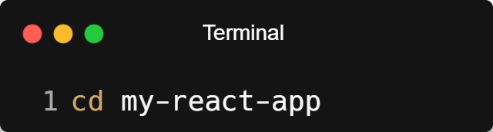
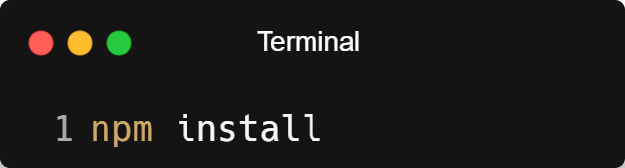
| Creating First React App with Vite
Step 3: Navigate into the Project Folder
Step 4: Install Dependencies

Slide 8

| Creating First React App with Vite
Step 5: Start the Development Server
Your app will be available at:
http://localhost:5173

Slide 9
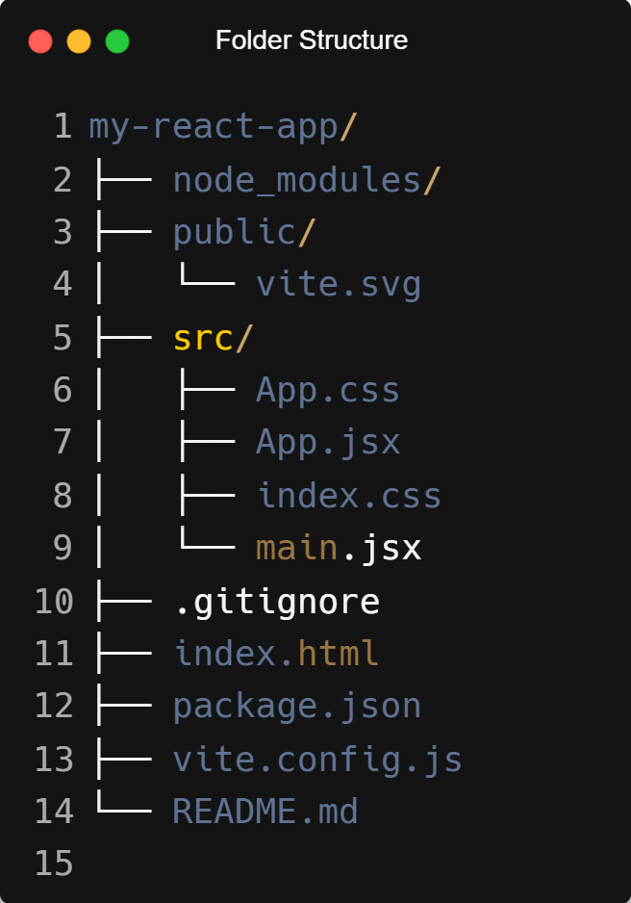
| Folder Structure

Slide 10
| Folder Structure
📂 1. node_modules/
Automatically created when you run npm install. Contains all the dependencies (packages/libraries) used in your app.
📂 2. public/
Contains static assets like images, icons, or fonts that won’t change during build.
vite.svg → Example SVG logo used in the starter project.
Files here are served directly — e.g., /vite.svg becomes accessible from the root URL.

Slide 11
| Folder Structure
📂 3. src/
This is where all your React code lives. You’ll spend most of your time here.
App.jsx Main React component — your app’s UI starts from here.
App.css Styles specific to the App component.
main.jsx The entry point of the app. It renders <App /> into the HTML page using ReactDOM.createRoot.
index.css Global styles that apply to the whole app.

Slide 12
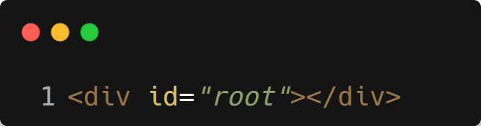
| Folder Structure
📄 4. index.html
This is the single HTML page where your React app is mounted. Look for this line:
That’s where React injects your entire UI.

Slide 13
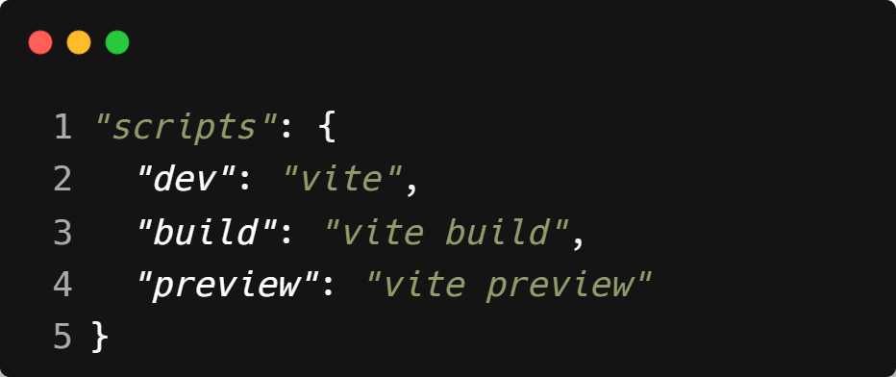
| Folder Structure
📄 5. package.json
Contains:
Project metadata
Installed dependencies
Scripts like:

Slide 14
| Folder Structure
📄 6. vite.config.js
Configuration file for Vite. You can customize build behavior, define aliases, use plugins, etc.
📄 7. .gitignore
Specifies files/folders to ignore in version control (like node_modules, .env, etc.).
📄 8. README.md
Introductory notes for your project. You can use it to document features, setup instructions, etc.

Slide 15

| Check Your Understanding
Question : What is the main role of a tool like Vite in a React project?
Options : a) To write the React code for you.
b) To provide a fast development server and an optimized build process for your application.
c) To host the final website online.
d) To check your code for spelling errors.
Answer : d) To provide a fast development server and an optimized build process
for your application.
Explanation:
Vite provides a modern development environment with features like a super-fast dev server with Hot Module Replacement (HMR) and a pre-configured build setup to bundle your code for production.

Slide 16
| References
MDN Web Docs : Comprehensive and official documentation for JS. 🔗https://developer.mozilla.org/en-US/docs/Web/JavaScript
W3Schools – JS Tutorial : Beginner-friendly JS tutorials with examples and interactive editors. 🔗 https://www.w3schools.com/js/
react.dev - A comprehensive, tutorial-style website that deeply explores core React concepts, including components, state, effects, and hooks, through interactive examples and in-depth explanations.
🔗https://react.dev/

Slide 17
Thanks
For
Watching
Course - Web Development - II
welcome@krmangalam.edu.in
Sohna Road,Gurugram,Haryana 122103

